Slide 1
Towards 50% Wind Electricity in Denmark
Paul-Frederik Bach
Energy Group Meeting
Rome
23 September 2015

Slide 2
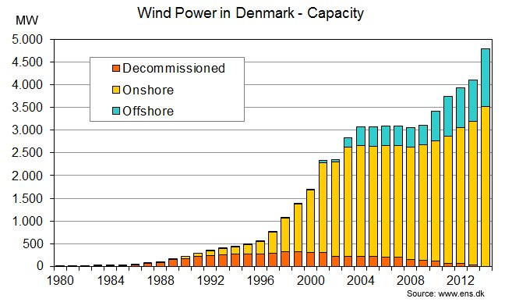
The Capacity Development

Slide 3
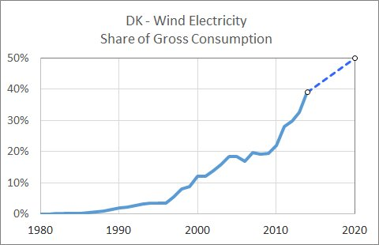
Nearly 40% Wind Electricity in 2014
Decisive conditions for a successful integration so far:
The strong interconnections
The development of international electricity markets
The IT revolution

Slide 4
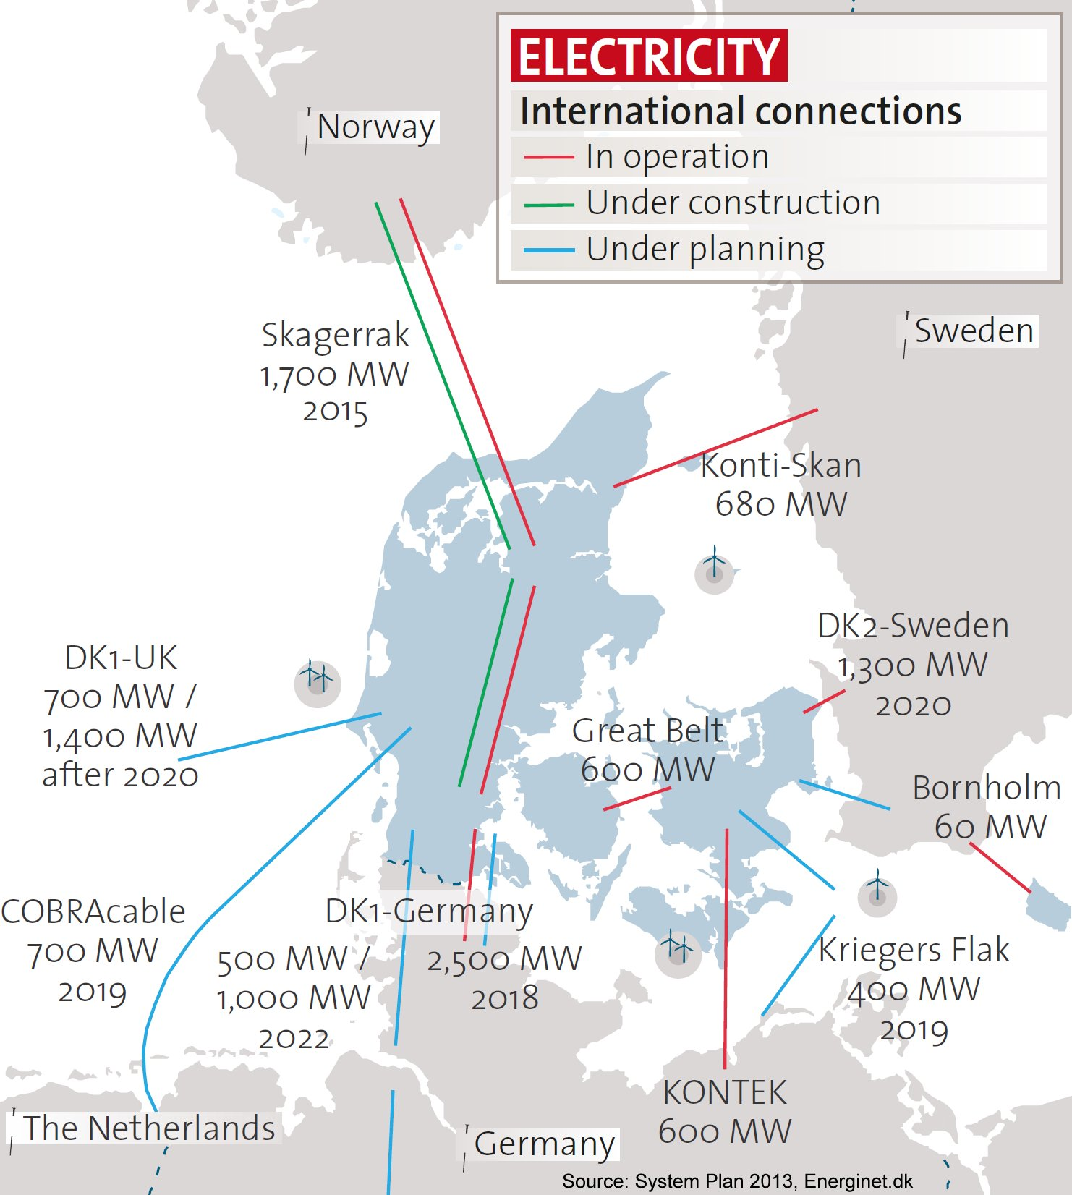
The Interconnections
More wind power
will take more
dispatchable capacity.
The dispatchable capacity
in Denmark is declining.
New interconnections
are supposed to replace
dispatchable capacity
in Denmark

Slide 5
Spot Prices Reveal Bottlenecks in the Grids
Optimal grid planning is a delicate balance
Grid reinforcements usually create new bottlenecks somewhere else
Congestion creates price differences
During the summer 2014 Denmark had the same spot price as Germany
There were bottlenecks between Denmark and the other Nordic countries
Danish spot prices switched toward Nordic prices in 2015
After commissioning of Skagerrak 4 (700 MW) the bottleneck has move to the German border
Now owners of wind turbines complain that spot prices do not even cover maintenance cost

Slide 6
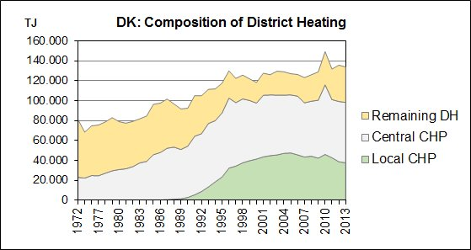
Heat and Electricity in Denmark
District heating supplies nearly 60% of all space heating in Denmark
73% of district heating was from Combined Heat and Power (CHP) in 2013
Two categories: Central CHP and Local CHP
Local CHP was encouraged by subsidies to end by 2018
Electricity production from CHP is flexible due to the heat storages
This flexibility is available now in contrast to Smart Grid flexibility

Slide 7
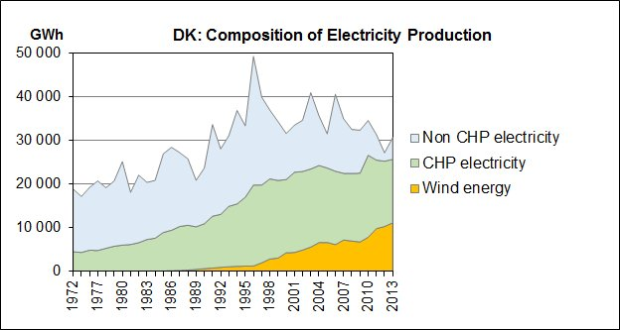
Trends in Thermal Electricity Production
The thermal electricity production has been falling since 1996
Non-CHP production is rapidly decreasing
Wind and CHP are now the dominating electricity sources
The CHP production is slightly declining from 18.4 TWh in 2001 to 14.6 TWh
Declining CHP production causes reduced operational flexibility

Slide 8
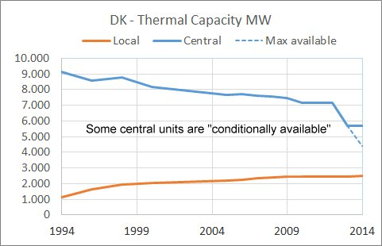
Thermal Capacity Adjusted to Business Volume
Denmark is no longer self-sufficient in all situations
CHP will be an increasing dilemma
Most of the small local CHP units will probably close down after 2018
Large municipalities acquire large CHP units

Slide 9
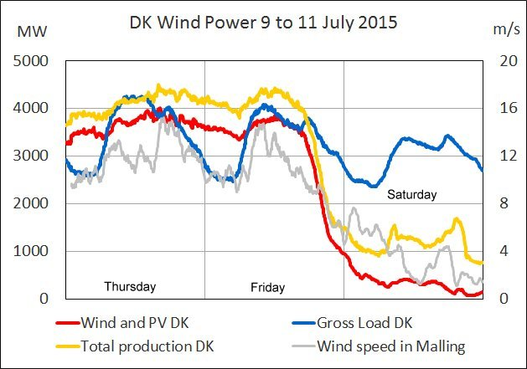
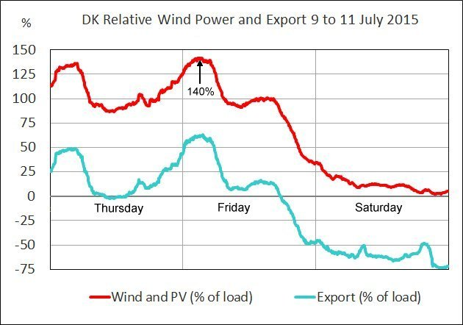
140% Wind Power in Denmark in 2015
Case:
A certain thermal capacity was kept running for security reasons
Wind power changes faster than wind speed
Most balancing services were purchased abroad
It is widely assumed that export prices are practically 0 while import prices are very high.
From Friday morning to Saturday night:
- Wind power from 140% to 2%
- Exchange from 60% export to 75%
import

Slide 10
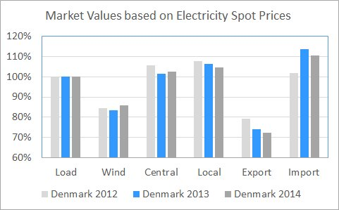
Facts about the Cost of Balancing Services
Average market values 2012-2014:
Value of wind energy: About 85% of demand value
Value of export: decreasing from 80% to 65% of import value
Domestic balancing services should be developed

Slide 11
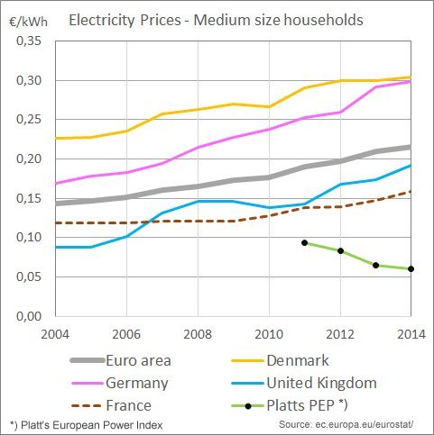
Increasing Electricity Prices at Consumer Level
The Euro area had 4% average annual rise from 2004 to 2014.
The influence of wind power is uncertain
There seems to be an increasing gap between consumer prices and wholesale prices.
The decline of wholesale prices is a problem to owners of thermal power plants
The gap may moderate consumers’ interest in active demand response.

Slide 12
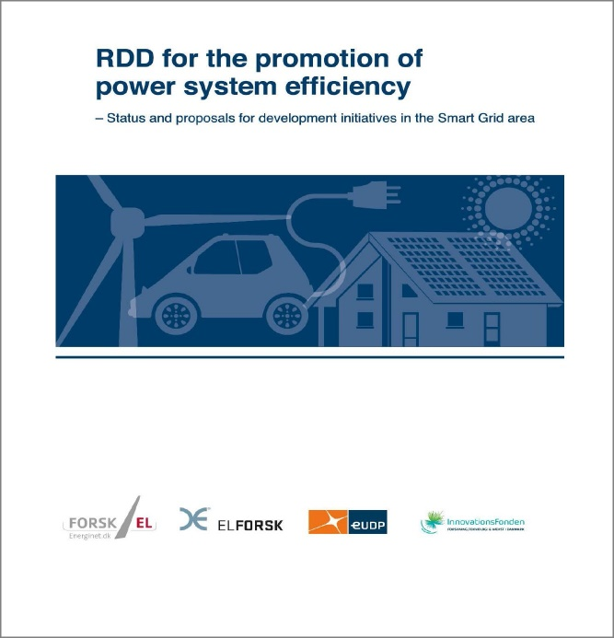
Smart Grid Research in Denmark
A recent report describes what needs to be developed and demonstrated in order to facilitate the use of 50% wind power in the power system by 2020.
Some main observations:
The research in market design and communi-cation was insufficient so far.
Technical sciences have dominated the research so far. Social sciences are necessary for efficient market design.
Flexible demand response has two purposes: Improving total system balance and preventing overload in local grids. It will take complex measures to unite the two considerations in one fair market model.
The cost-benefit report from 2010 should be updated. Essential assumptions, such as PV capacity and penetration of electric cars, are continuously changing.
Several proposed measures are based on fluctuating market prices. Potential measures should be analysed together because they will have an impact on market prices.
The implementation of demand response in Denmark will take years.
The dissemination of research results is insufficient. How can the practical use of research results be improved?

Slide 13
Thank you!
www.pfbach.dk

